Slide 1
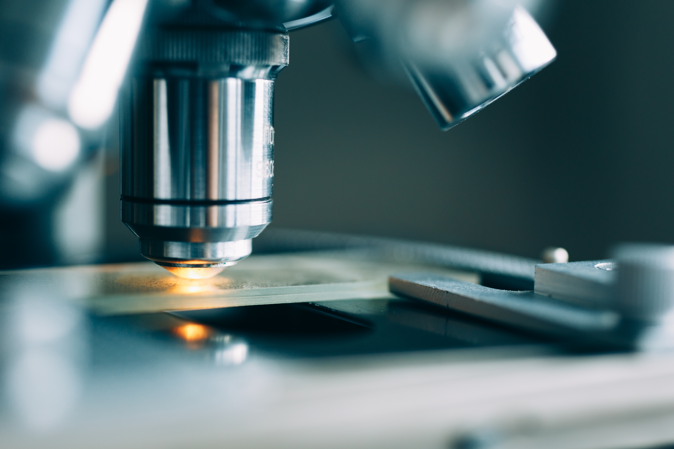
Computer Aided Diagnosis

Slide 2
What is the Computer Aided Diagnosis
Using imaging, medical image processing technology, and other methods, combined with computer analysis and calculation.
The aim is to improve the accuracy of diagnosis

Slide 3
What is the steps of computer aided diagnosis
Three steps！
1 Image processing (preprocessing)
2 Extraction of image features
3 data processing

Slide 4
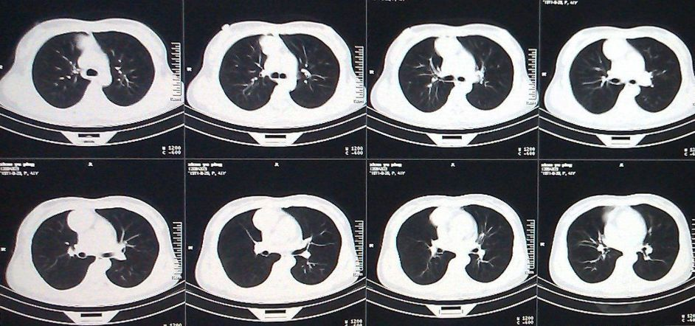
Research Field
Computer Aided Diagnosis Based on Cancer Images

Slide 5
Research Direction
1 Image pre-processing
2 Clinical Applications
3 Future potential

Slide 6
Conclusion
1 Computer -assisted diagnosis can only make suggestions for doctors' judgments by data processing. The current technology does not support fully replacement.
2 Computer -assisted diagnosis is not particularly mature in the current development, mainly in the field of breast cancer and lung cancer.

